Slide 1
NLP-BASED BOOK RECOMMENDER
Yaqeen Al Mahdi

Slide 2
Outline
Problem Description
Data Preprocessing
Data Acquisition
Modeling Experiments
Scope

Slide 3

Problem Description

Slide 4
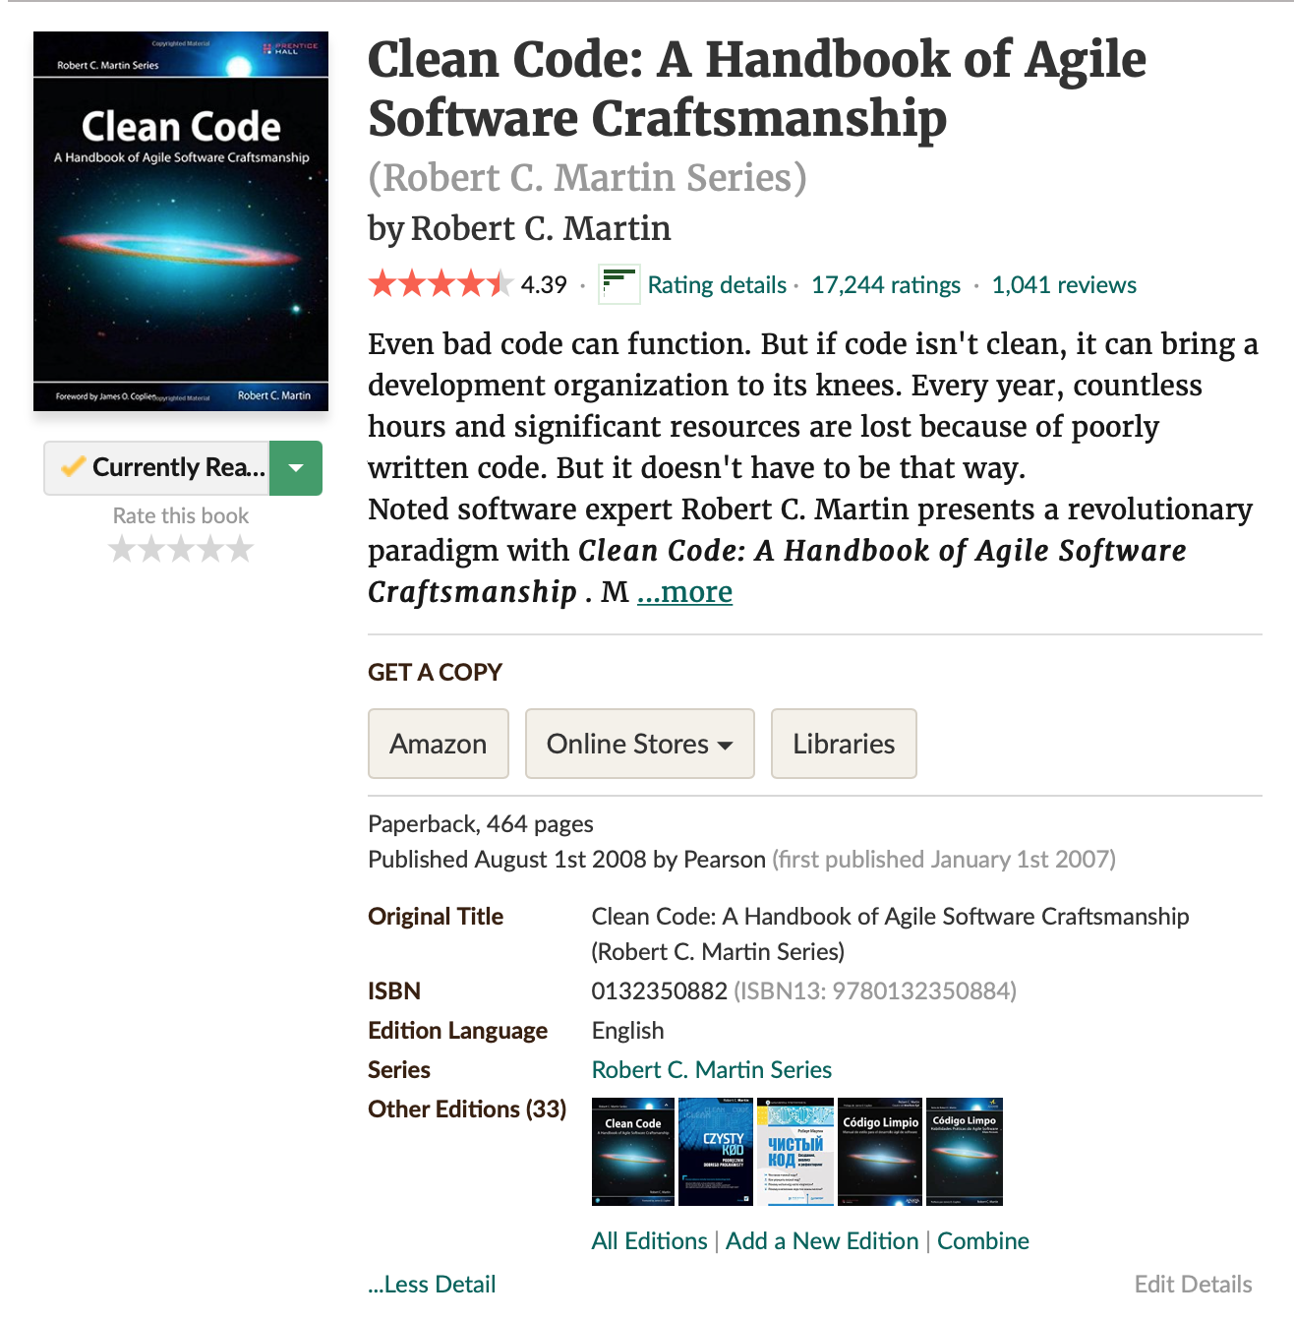
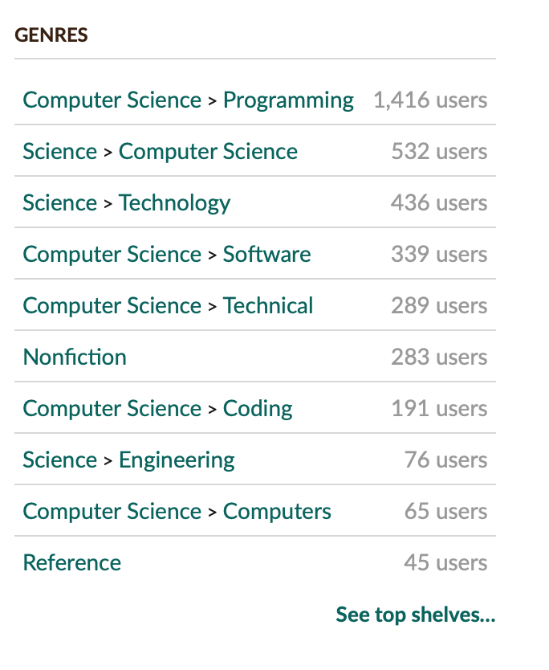
Problem Description

Slide 5
Problem Description

Slide 6
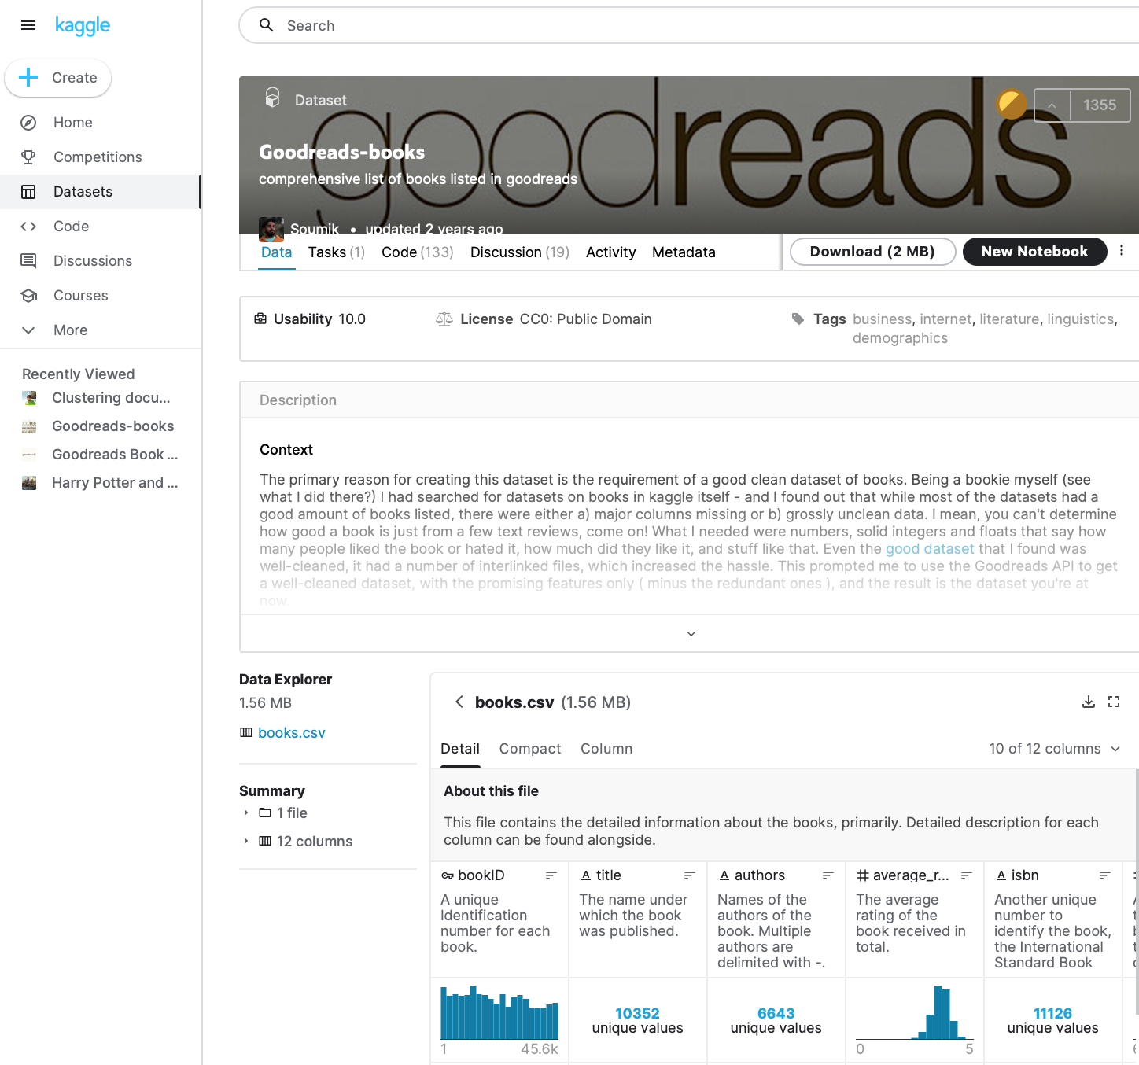
Data Acquisition

Slide 7
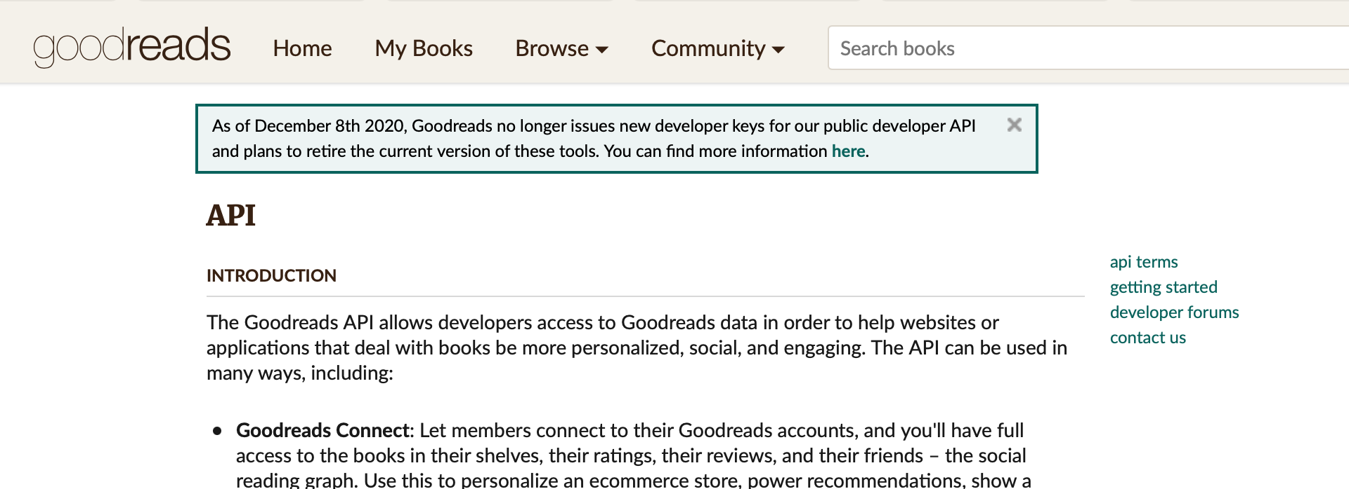
Data Acquisition

Slide 8

Data Acquisition

Slide 9
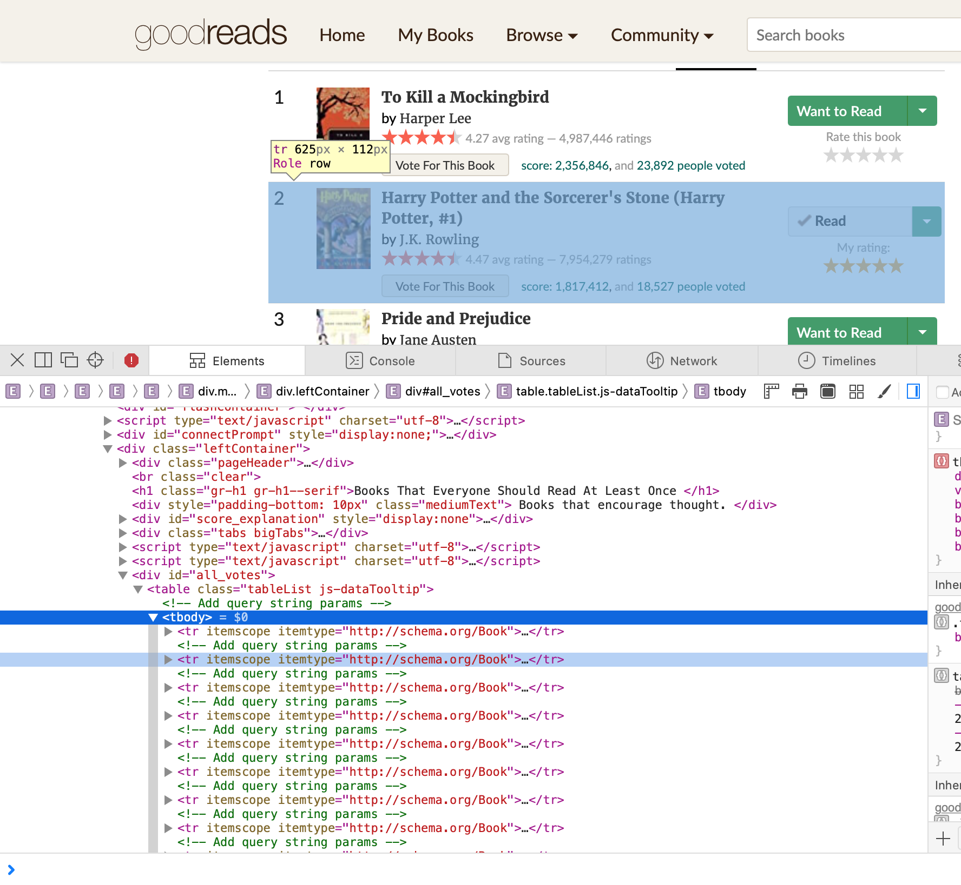
Data Acquisition
BeautifulSoap!

Slide 10

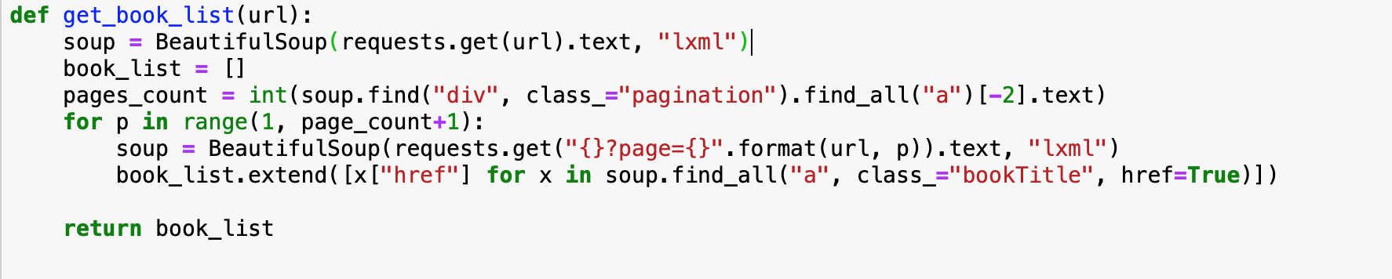
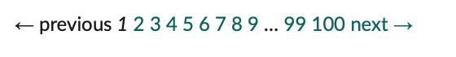
Data Acquisition

Slide 11
Data Acquisition

Slide 12
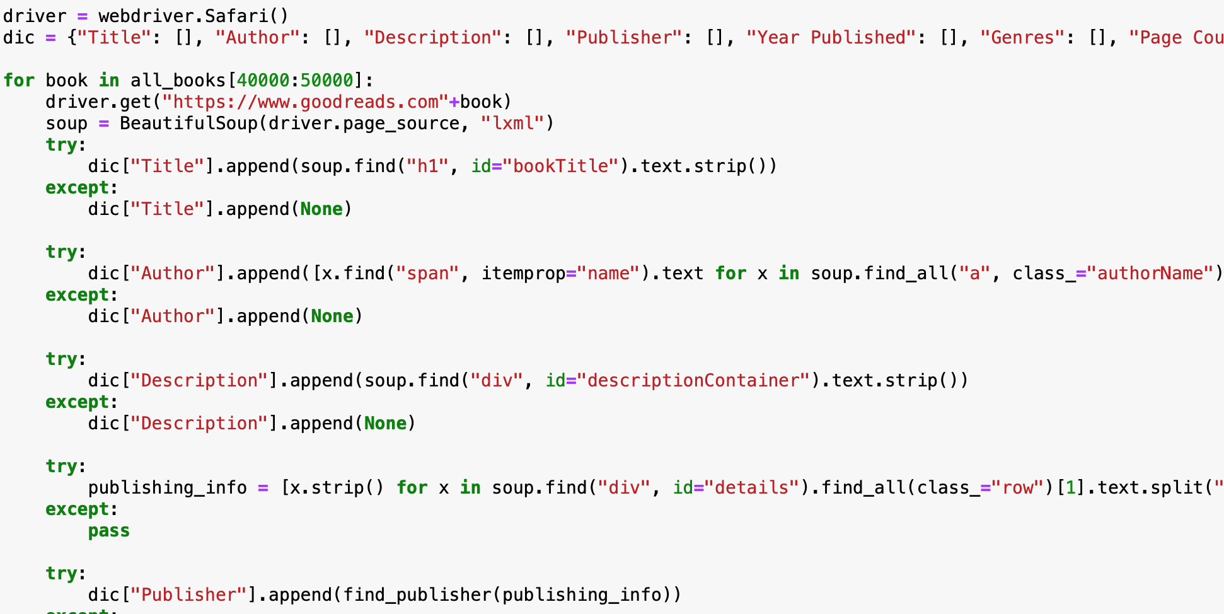
Data Acquisition

Slide 13
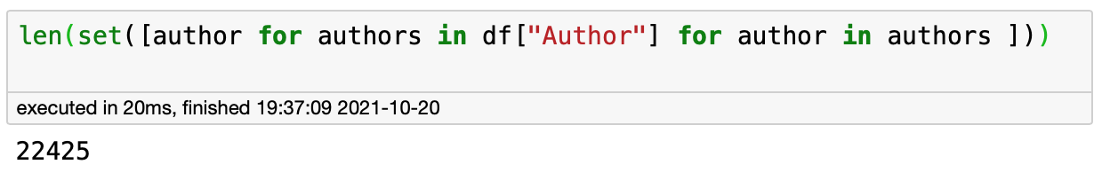
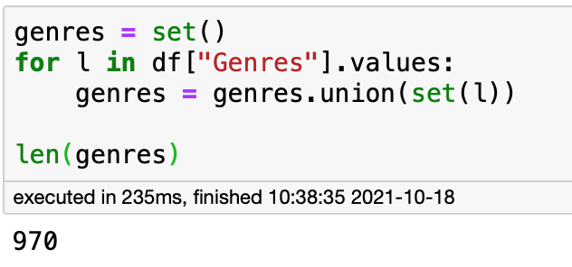
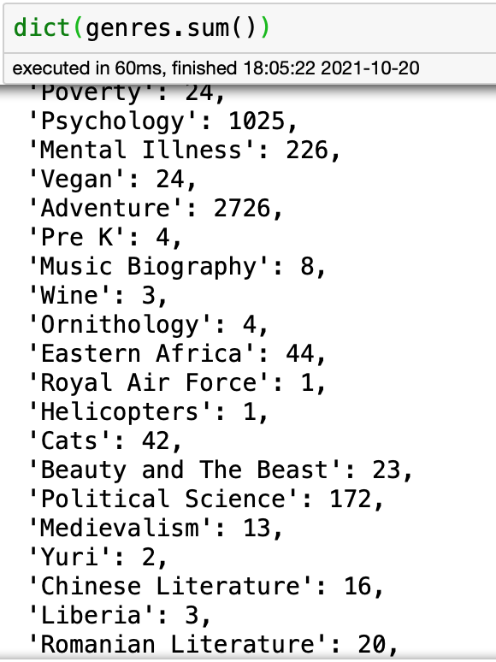
Scope
Collected Features:
Title
Author
Description
Publisher
Year published
Genres
Page count

Slide 14
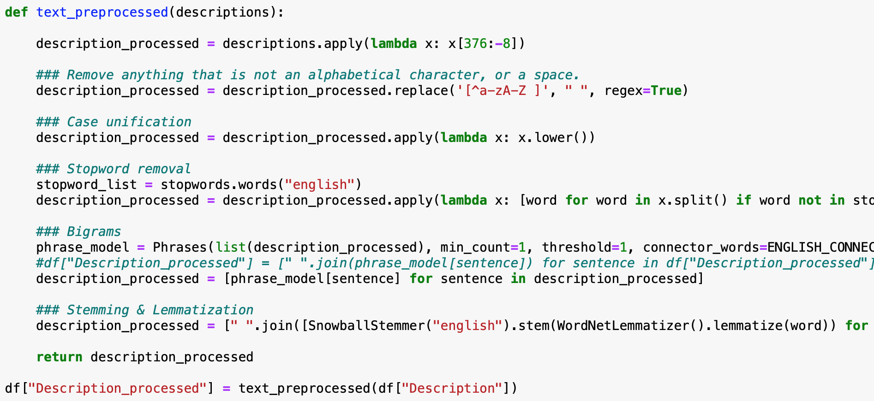
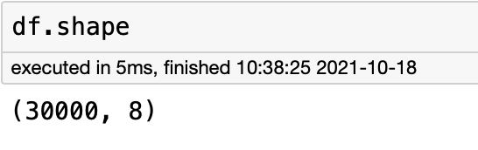
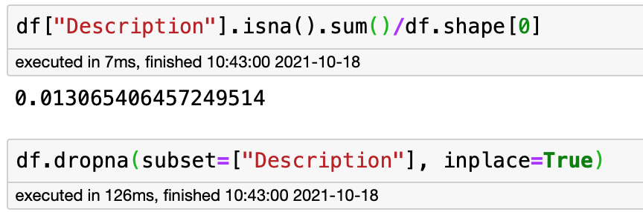
Scope

Slide 15
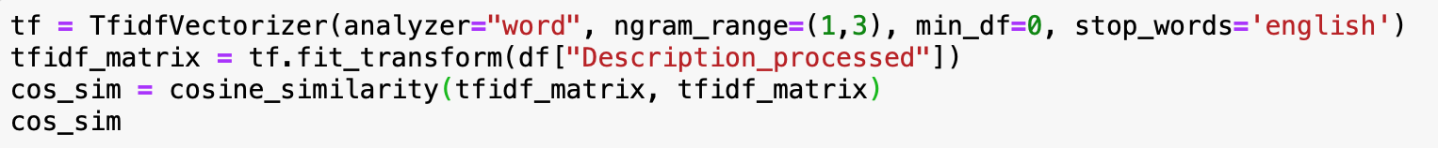
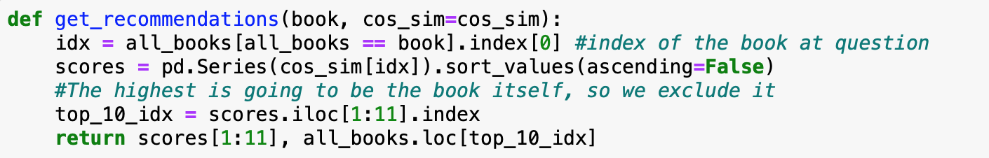
Experiment #1: TF-IDF and Cosine Similarity

Slide 16
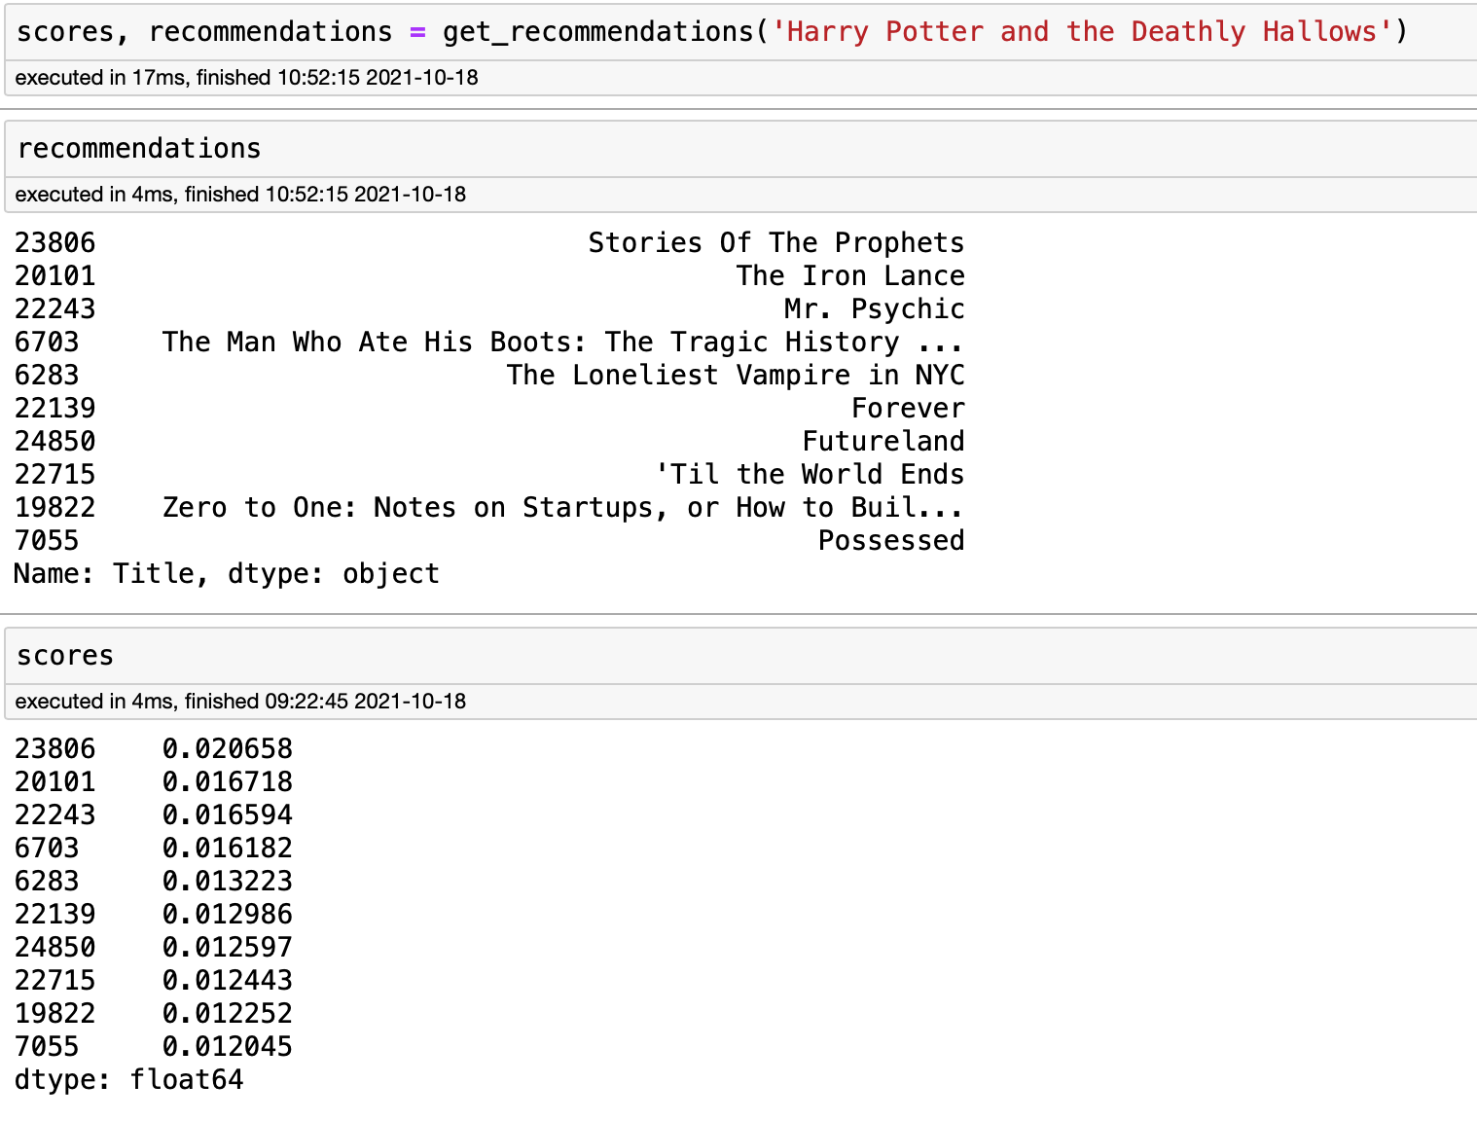
Experiment #1: TF-IDF and Cosine Similarity

Slide 17
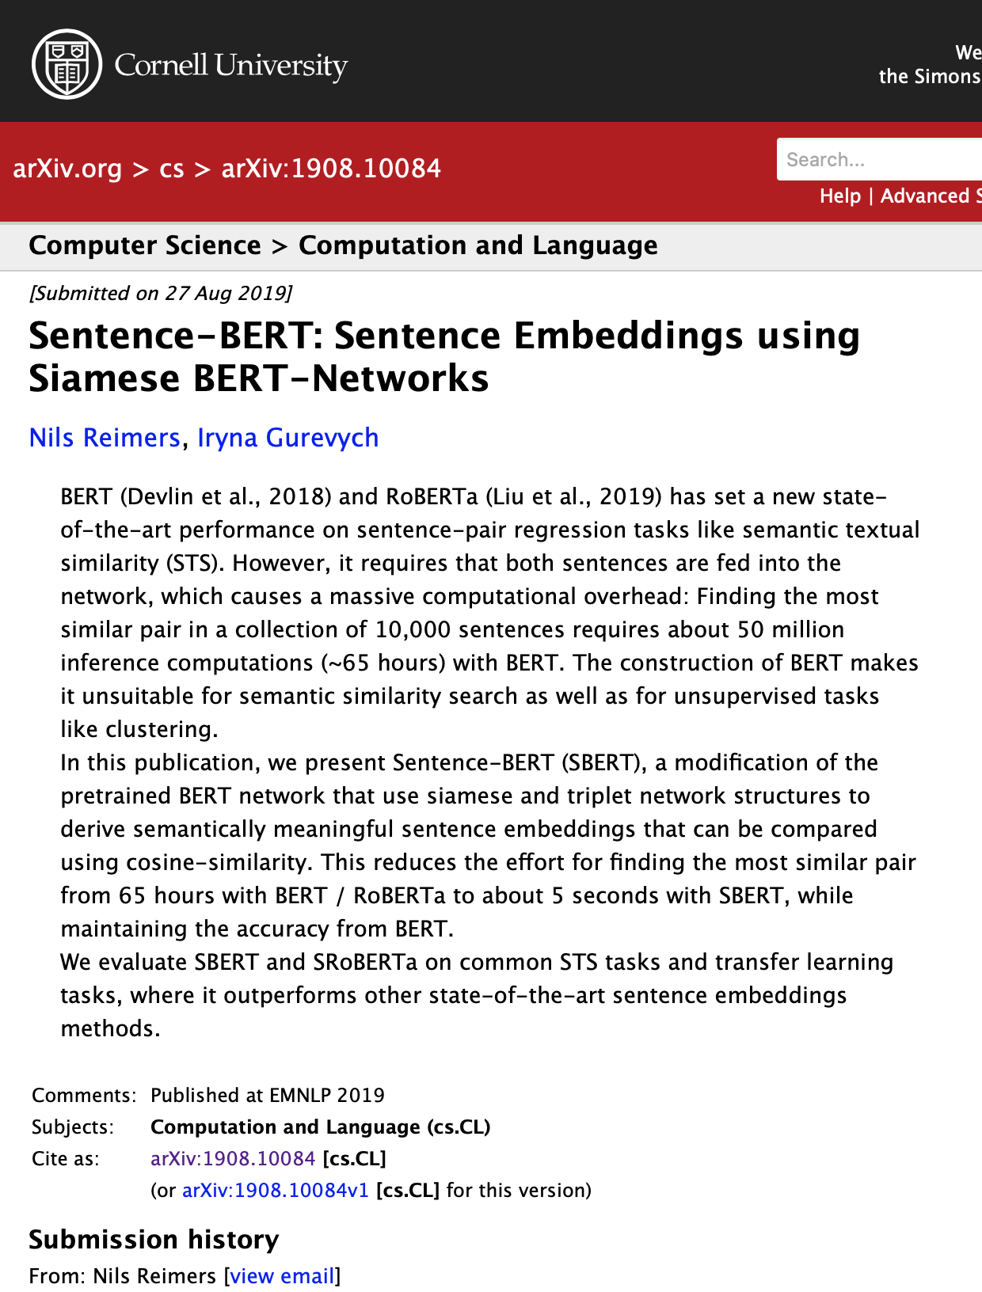
Experiment #2: Sentence Transformers/BERT and Cosine Similarity
Bidirectional Encoder Representations: a transformer-based machine learning technique for natural language processing pre-training developed by Google.
Notes:
https://towardsdatascience.com/bert-explained-state-of-the-art-language-model-for-nlp-f8b21a9b6270

Slide 18
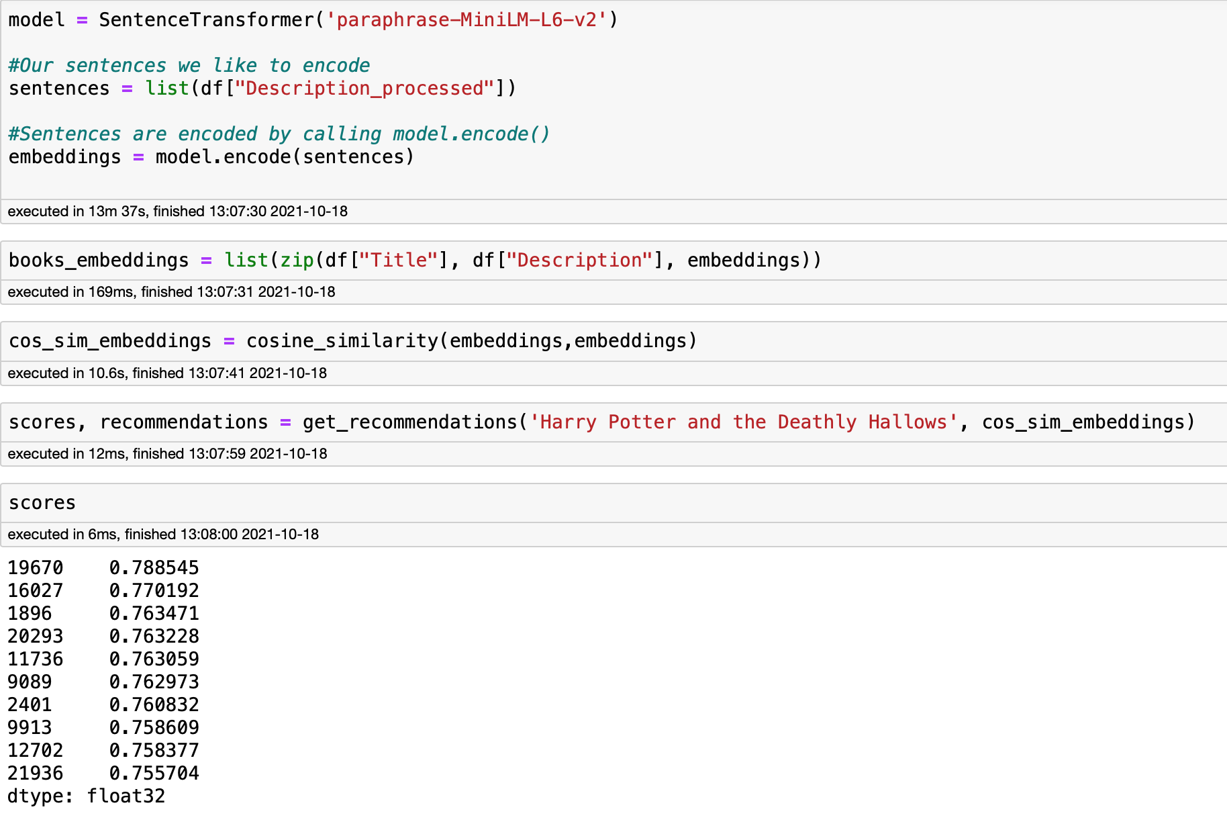
Experiment #2: Sentence Transformers/BERT and Cosine Similarity

Slide 19
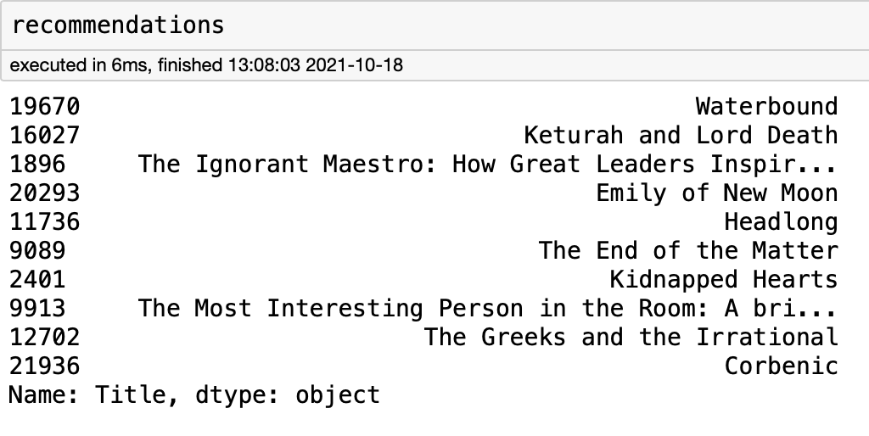
Experiment #2: Sentence Transformers/BERT and Cosine Similarity

Slide 20
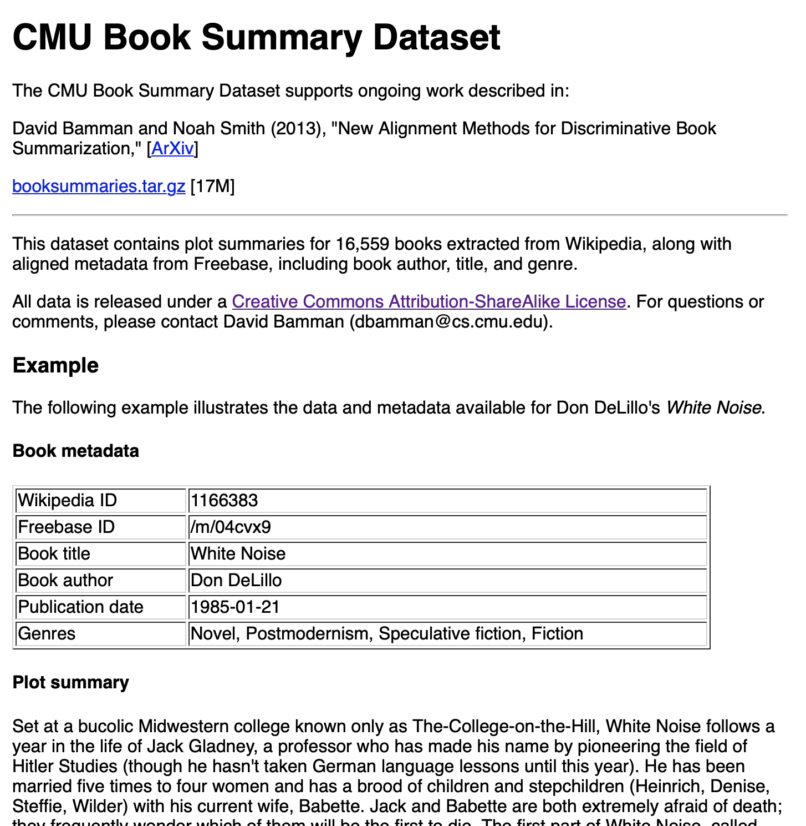
Experiment #2: Sentence Transformers/BERT and Cosine Similarity

Slide 21
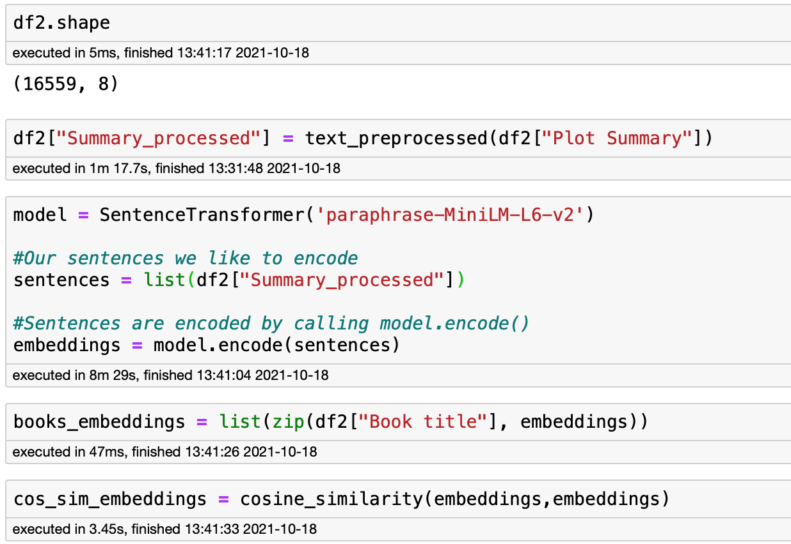

Slide 22
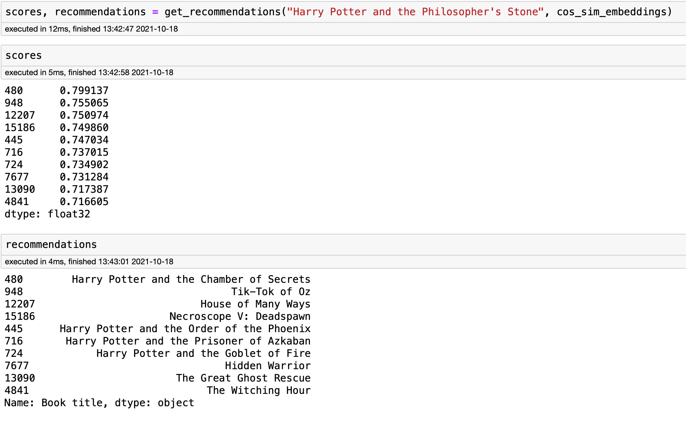

Slide 23
Experiment #3: Embedding with Clustering

Slide 24
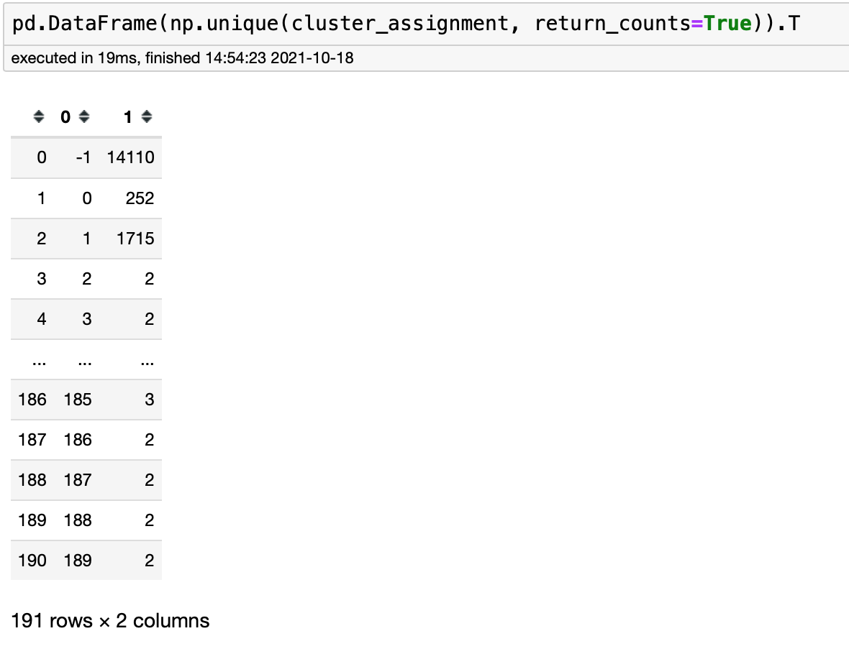
Experiment #3: Embedding with Clustering

Slide 25
Thank You

